Slide 1

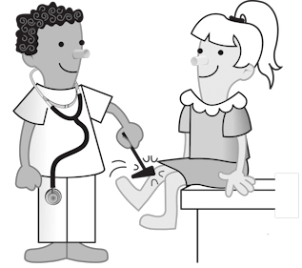
The Spinal Cord, Spinal Nerves, and Somatic Reflexes
Somatic Reflexes
Al-Farabi Kazakh National University
Higher School of Medicine

Slide 2
LEARNING OUTCOMES
When you have completed this section, you should be able to:
a. define reflex and explain how reflexes differ from other motor actions;
b. describe the general components of a typical reflex arc;
c. explain how the basic types of somatic reflexes function.
Al-Farabi Kazakh National University
Higher School of Medicine

Slide 3
Introduction

Slide 4
Most of us have had our reflexes tested with a little rubber hammer; a tap below the knee produces an uncontrollable jerk of the leg, for example. In this section, we discuss what reflexes are and how they are produced by an assembly of receptors, neurons, and effectors. We also survey the different types of neuromuscular reflexes and how they are important in motor coordination of our everyday tasks.

Slide 5
The Nature of Reflexes

Slide 6
Reflexes are quick, involuntary, stereotyped reactions of glands or muscles to stimulation. This definition sums up four important properties:
1. Reflexes require stimulation—they are not spontaneous actions like muscle tics but responses to sensory input.
2. Reflexes are quick—they generally involve only a few interneurons, or none, and minimum synaptic delay.
Al-Farabi Kazakh National University
Higher School of Medicine

Slide 7
3. Reflexes are involuntary—they occur without intent, often without our awareness, and they are difficult to suppress. Given an adequate stimulus, the response is essentially automatic. You may become conscious of the stimulus that evoked a reflex, and this awareness may enable you to correct or avoid a potentially dangerous situation, but awareness is not a part of the reflex itself. It may come after the reflex action has been completed, and somatic reflexes can occur even if the spinal cord has been severed so that no stimuli reach the brain.
4. Reflexes are stereotyped—they occur in essentially the same way every time; the response is very predictable, like the variability of voluntary movement.
Al-Farabi Kazakh National University
Higher School of Medicine

Slide 8
Reflexes include glandular secretion and contractions of all three types of muscle. The reflexes of skeletal muscle are called somatic reflexes, since they involve the somatic nervous system.
Somatic reflexes have traditionally been called spinal reflexes, but this is a misleading expression for two reasons:
(1) Spinal reflexes are not exclusively somatic; visceral reflexes also involve the spinal cord.
(2) Some somatic reflexes are mediated more by the brain than by the spinal cord.
Al-Farabi Kazakh National University
Higher School of Medicine

Slide 9
A somatic reflex employs a reflex arc, in which signals travel along the following pathway (fig. 13.20):
somatic receptors in the skin, muscles, and tendons;
afferent nerve fibers, which carry information from these receptors to the posterior horn of the spinal cord or to the brainstem;
an integrating center, a point of synaptic contact between neurons in the gray matter of the cord or brainstem;
efferent nerve fibers, which carry motor impulses to the muscles;
effectors, the muscles that carry out the response.
Al-Farabi Kazakh National University
Higher School of Medicine

Slide 10
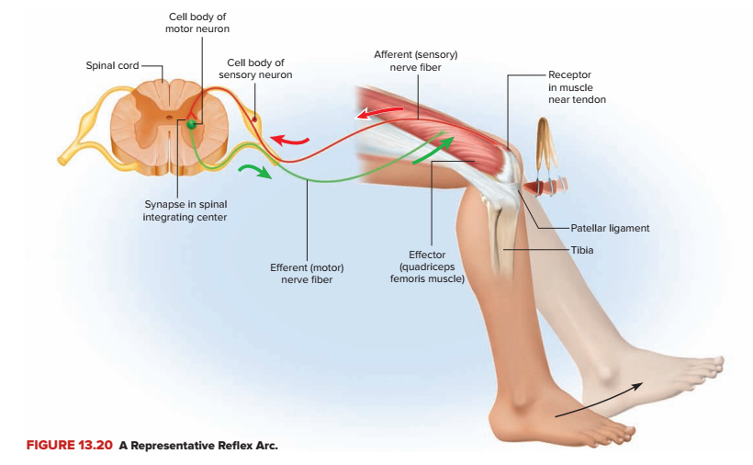
Al-Farabi Kazakh National University
Higher School of Medicine

Slide 11
In most reflex arcs, the integrating center includes one or more interneurons. Synaptic events in the integrating center determine whether the efferent neurons issue signals to the muscles.
The more interneurons there are, the more complex the information processing can be, but with more synapses, there is a longer delay between input and output.
Al-Farabi Kazakh National University
Higher School of Medicine

Slide 12
The Muscle Spindle

Slide 13
Many somatic reflexes involve stretch receptors called muscle spindles embedded in the muscles.
These are among the body’s proprioceptors, sense organs specialized to monitor the position and movement of body parts.
The function of muscle spindles is to inform the brain of muscle length and body movements. This enables the brain to send motor commands back to the muscles that control muscle tone, posture, coordinated movement, and corrective reflexes (for example, to keep one’s balance).

Slide 14
Spindles are especially abundant in muscles that require fine control.
Hand and foot muscles have 100 or more spindles per gram of muscle, whereas there are relatively few in large muscles with coarse movements, and none at all in the middle-ear muscles.
Al-Farabi Kazakh National University
Higher School of Medicine

Slide 15
A muscle spindle is a bundle of usually seven or eight small, modified muscle fibers enclosed in an elongated fibrous capsule about 5 to 10 mm long (fig. 13.21).
Spindles are especially concentrated at the ends of a muscle, near its tendons.
The modified muscle fibers within the spindle are called intrafusal²⁶ fibers, whereas those that make up the rest of the muscle and do its work are called extrafusal fibers.
²⁶intra = within; fus = spindle

Slide 16
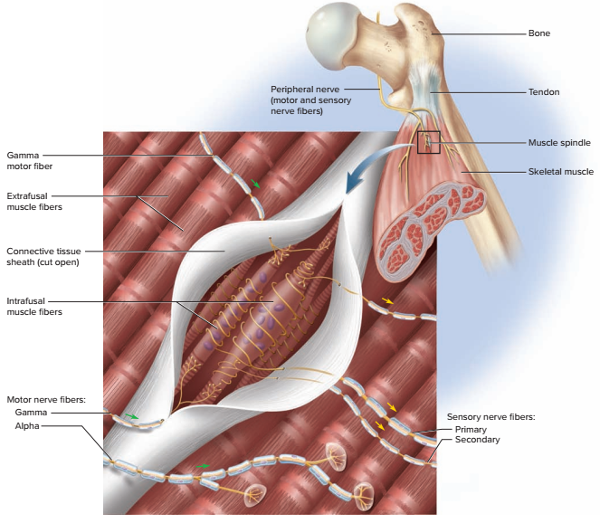
FIGURE 13.21 A Muscle Spindle and Its Innervation.

Slide 17
Each end of an intrafusal fiber has a few sarcomeres. A gamma motor neuron of the spinal cord innervates each end and stimulates its contraction. This maintains tension and sensitivity of the intrafusal fiber, preventing it from going slack like an unstretched rubber band when a muscle shortens.
Al-Farabi Kazakh National University
Higher School of Medicine

Slide 18
Spinal motorneurons that supply the extrafusal muscle fibers are called alpha motor neurons. Up to now, we have studied only that type and the neuromuscular junctions they form with muscle, but nearly one-third of all spinal motor neurons are the gamma type — evidence of the great importance of muscle spindles.
Al-Farabi Kazakh National University
Higher School of Medicine

Slide 19
The long midportion of an intrafusal fiber lacks sarcomeres and cannot contract, but is supplied by two types of sensory nerve fibers: primary afferent fibers that monitor muscle length and how rapidly it changes, which are therefore very responsive to sudden body movements; and secondary afferent fibers that monitor length only, not rate of change.
Al-Farabi Kazakh National University
Higher School of Medicine

Slide 20
Both of these sensory fiber types enter the posterior horn of the spinal cord, synapse on the alpha motor neurons and regulate their firing, and also send branches up the spinal cord to the brain. Through these fibers, the brain constantly but subconsciously monitors the length and tension of nearly every skeletal muscle throughout the body. This input is vital to the maintenance of posture, fine control of movements, and corrective reflexes.
Al-Farabi Kazakh National University
Higher School of Medicine

Slide 21
FOR EXAMPLE, you are standing on the deck of a boat that is gently rocking on the waves. At one moment, your body begins to tip forward. This stretches your calf muscles and their muscle spindles, setting off sensory signals to the spinal cord. The CNS responds to this by tensing your calf muscles to keep you from falling and to restore or maintain your upright posture. Then the boat rocks the other way and you begin to tip to the rear. The spindles in the calf muscles are now compressed and their signaling rate drops. Such input from the spindles inhibits the alpha motor neurons of the calf muscles, relaxing those muscles so they don’t pull you farther backward. At the same time, your backward tilt stretches spindles in your anterior leg and thigh muscles, leading to their contraction and preventing you from falling over backward.
Al-Farabi Kazakh National University
Higher School of Medicine

Slide 22
The Stretch Reflex

Slide 23
When a muscle is suddenly stretched, it “fights back”—it contracts, increases tone, and feels stiffer than an unstretched muscle. This response, called the stretch (myotatic²⁷) reflex, helps to maintain equilibrium and posture, as we just saw in the rocking boat example. To take another case, if your head starts to tip forward, it stretches muscles at the back of your neck. This stimulates their muscle spindles, which send signals to the cerebellum by way of the brainstem. The cerebellum integrates this information and relays it to the cerebral cortex, and the cortex sends signals back, via the brainstem, to the muscles. The muscles contract and raise your head.
²⁷myo = muscle; tat (from tasis) = stretch

Slide 24
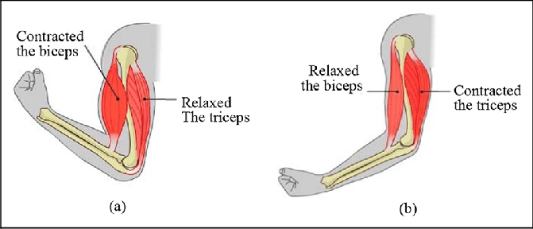
Stretch reflexes often feed back not to a single muscle but to a set of synergists and antagonists. Since the contraction of a muscle on one side of a joint stretches the antagonist on the other side, the flexion of a joint creates a stretch reflex in the extensors, and extension creates a stretch reflex in the flexors.
Think of the way your biceps brachii is stretched when you extend your elbow, for example.

Slide 25
A stretch reflex is mediated primarily by the brain and is not, therefore, strictly a spinal reflex, but a weak component of it is spinal and occurs even if the spinal cord is severed from the brain. The spinal component can be more pronounced if a muscle is stretched very suddenly. This occurs in the reflexive contraction of a muscle when its tendon is tapped, as in the familiar patellar (knee-jerk) reflex.
Al-Farabi Kazakh National University
Higher School of Medicine

Slide 26
Tapping the patellar ligament with a reflex hammer abruptly stretches the quadriceps femoris muscle of the thigh (fig. 13.22). This stimulates numerous muscle spindles in the quadriceps and sends an intense volley of signals to the spinal cord, mainly by way of primary afferent fibers.
In the spinal cord, these fibers synapse directly with the alpha motor neurons that return to the muscle, thus forming monosynaptic reflex arcs. That is, there is only one synapse between the afferent and efferent neuron, so there is little synaptic delay and a very prompt response. The alpha motor neurons excite the quadriceps, making it contract and creating the knee jerk.

Slide 27
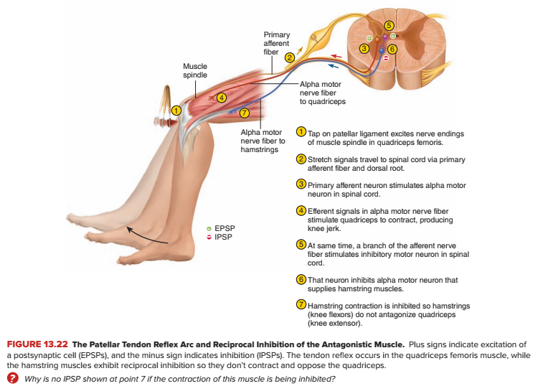

Slide 28
There are many other tendon reflexes. A tap on the calcaneal tendon causes plantar flexion of the foot, a tap on the triceps brachii tendon causes extension of the elbow, and a tap on the masseter causes clenching of the jaw.
Testing somatic reflexes is valuable in diagnosing many diseases that cause exaggeration, inhibition, or absence of reflexes—for example, neurosyphilis and other infectious diseases, diabetes mellitus, multiple sclerosis, alcoholism, hormone and electrolyte imbalances, and lesions of the nervous system.
Al-Farabi Kazakh National University
Higher School of Medicine

Slide 29
Stretch reflexes and other muscle contractions often depend on reciprocal inhibition, a reflex that prevents muscles from working against each other by inhibiting antagonists. In the knee jerk, for example, the quadriceps would not produce much joint movement if its antagonists, the hamstring muscles, contracted at the same time. But reciprocal inhibition prevents that from happening. Some branches of the sensory fibers from the quadriceps muscle spindles stimulate spinal interneurons that, in turn, inhibit the alpha motor neurons of the hamstrings (fig. 13.22). The hamstrings remain relaxed and allow the quadriceps to extend the knee.
Al-Farabi Kazakh National University
Higher School of Medicine

Slide 31
The Flexor (Withdrawal) Reflex

Slide 32
A flexor reflex is the quick contraction of flexor muscles resulting in the withdrawal of a limb from an injurious stimulus. For example, suppose you are wading in a lake and step on a broken bottle with your right foot (fig. 13.23). Even before you are consciously aware of the pain, you quickly pull your foot away before the glass penetrates any deeper. This action involves contraction of the flexors and relaxation of the extensors in that limb; the latter is another case of reciprocal inhibition.
Al-Farabi Kazakh National University
Higher School of Medicine

Slide 33
The protective function of this reflex requires more than a quick jerk like a tendon reflex, so it involves more complex neural pathways. Sustained contraction of the flexors is produced by a parallel after-discharge circuit in the spinal cord (see fig. 12.31).
This circuit is part of a polysynaptic reflex arc—a pathway in which signals travel over many synapses on their way back to the muscle.
Al-Farabi Kazakh National University
Higher School of Medicine

Slide 34
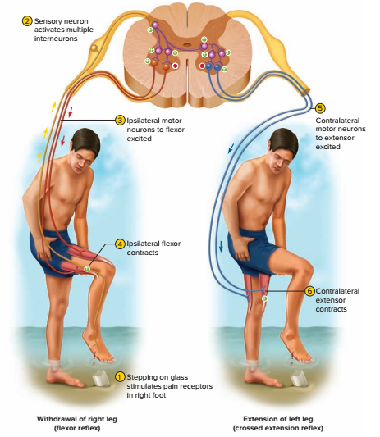
FIGURE 13.23 The Flexor and Crossed Extension Reflexes. A pain stimulus triggers a withdrawal reflex, which results in contraction of flexor muscles of the injured limb. At the same time, a crossed extension reflex results in contraction of extensor muscles of the opposite limb. The latter reflex aids in balance when the injured limb is raised. Note that for each limb, while the agonist contracts, the alpha motor neuron to its antagonist is inhibited, as indicated by the red minus signs in the spinal cord.

Slide 35
The Crossed Extension Reflex

Slide 36
In the preceding situation, if all you did was to quickly lift the injured leg from the lake bottom, you would fall over. To prevent this and maintain your balance, other reflexes shift your center of gravity over the leg that is still planted on the ground. The crossed extension reflex is the contraction of extensor muscles in the limb opposite from the one that is withdrawn (fig. 13.23). It extends and stiffens that limb and enables you to keep your balance.
Al-Farabi Kazakh National University
Higher School of Medicine

Slide 37
FIGURE 13.23 The Flexor and Crossed Extension Reflexes. A pain stimulus triggers a withdrawal reflex, which results in contraction of flexor muscles of the injured limb. At the same time, a crossed extension reflex results in contraction of extensor muscles of the opposite limb. The latter reflex aids in balance when the injured limb is raised. Note that for each limb, while the agonist contracts, the alpha motor neuron to its antagonist is inhibited, as indicated by the red minus signs in the spinal cord.

Slide 38
To produce this reflex, branches of the afferent nerve fibers cross from the stimulated side of the body to the contralateral side of the spinal cord. There, they synapse with interneurons, which, in turn, excite or inhibit alpha motor neurons to the muscles of the contralateral limb.
Al-Farabi Kazakh National University
Higher School of Medicine

Slide 39
The flexor reflex employs an ipsilateral reflex arc — one in which the sensory input and motor output are on the same side of the spinal cord. The crossed extension reflex employs a сontralateral reflex arc, in which the input and output are on opposite sides. An intersegmental reflex arc is one in which the input and output occur at different levels (segments) of the spinal cord—for example, when pain to the foot causes contractions of abdominal and hip muscles higher up the body. Note that all of these reflex arcs can function simultaneously to produce a coordinated protective response to pain
Al-Farabi Kazakh National University
Higher School of Medicine

Slide 40
The Tendon Reflex

Slide 41
Tendon organs are proprioceptors located in a tendon near its junction with a muscle (fig. 13.24). A tendon organ is about 0.5 mm long. It consists of an encapsulated bundle of small, loose collagen fibers and one or more nerve fibers that penetrate the capsule and end in flattened leaflike processes between the collagen fibers. As long as the tendon is slack, its collagen fibers are slightly spread and put little pressure on the nerve endings.
When muscle contraction pulls on the tendon, the collagen fibers come together like the two sides of a stretched rubber band and squeeze the nerve endings between them. The nerve fiber sends signals to the spinal cord that provide the CNS with feedback on the degree of muscle tension at the joint.
Al-Farabi Kazakh National University
Higher School of Medicine

Slide 42
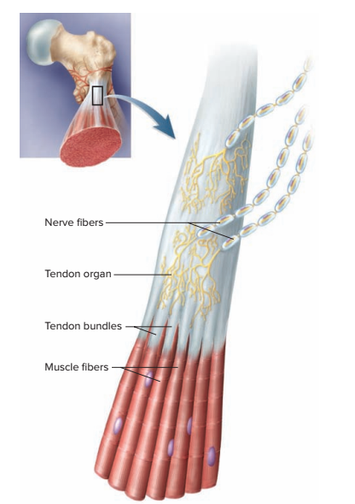
FIGURE 13.24 A Tendon Organ.

Slide 43
The tendon reflex is a response to excessive tension on the tendon. It inhibits alpha motor neurons to the muscle so the muscle does not contract as strongly. This serves to moderate muscle contraction before it tears a tendon or pulls it loose from the muscle or bone. Nevertheless, strong muscles and quick movements sometimes damage a tendon before the reflex can occur, causing such athletic injuries as a ruptured calcaneal tendon.
Al-Farabi Kazakh National University
Higher School of Medicine

Slide 44
To produce this reflex, branches of the afferent nerve fibers cross from the stimulated side of the body to the contralateral side of the spinal cord. There, they synapse with interneurons, which, in turn, excite or inhibit alpha motor neurons to the muscles of the contralateral limb.
The tendon reflex also functions when some parts of a muscle contract more than others. It inhibits the muscle fibers connected with overstimulated tendon organs so their contraction is more comparable to the contraction of the rest of the muscle. This spreads the workload more evenly over the entire muscle, which is beneficial in such actions as maintaining a steady grip on a tool.
Al-Farabi Kazakh National University
Higher School of Medicine

Slide 45
TABLE 13.7 | Some Disorders of the Spinal Cord and Spinal Nerves
Guillain–Barré syndrome | An acute demyelinating nerve disorder often triggered by viral infection, resulting in muscle weakness, elevated heart rate, unstable blood pressure, shortness of breath, and sometimes death from respiratory paralysis
Neuralgia | General term for nerve pain, often caused by pressure on spinal nerves from herniated intervertebral discs
Paresthesia | Abnormal sensations of prickling, burning, numbness, or tingling; a symptom of peripheral nerve disorders
Peripheral neuropathy | Any loss of sensory or motor function due to nerve injury; also called nerve palsy
Rabies (hydrophobia) | A disease usually contracted from animal bites, involving viral infection that spreads via somatic motor nerve fibers to the CNS and then autonomic nerve fibers; leads to seizures, coma, and death; invariably fatal if not treated before CNS symptoms appear
Spinal meningitis | Inflammation of the spinal meninges due to viral, bacterial, or other infection

Slide 46

Before You Go On
Answer these questions from memory. Reread the preceding section if there are too many you don’t know.
1. Name five structural components of a typical somatic reflex arc. Which of these is absent from a monosynaptic arc?
2. State the function of each of the following in a muscle spindle: intrafusal fibers, gamma motor neurons, and primary afferent fibers.
3. Explain how nerve fibers in a tendon sense the degree of tension in a muscle.
4. Why must the withdrawal reflex, but not the stretch reflex, involve a polysynaptic reflex arc?
5. Explain why the crossed extension reflex must accompany a withdrawal reflex of the leg
Al-Farabi Kazakh National University
Higher School of Medicine

